Slide 1

Street Manager Tips & Tricks
March 2020

Slide 2


Introduction
Over the past few months, the Street Manager team has been collating a ‘hole’ heap of tips & tricks for your organisation to take advantage of when using the system.
Please get in touch with us if you have found any other hints and tips either via the Business Change App or email to Streetmanager@dft.gov.uk.

Slide 3
Contents
1
Navigation, Search & Filtering
2
Work records/Permits
3
Section 81s [S81s]
4
Fixed Penalty Notices [FPNs]
5
Section 58s [S58s]
6
Comments
7
Fees Reporting
8
Unattributable Works

Slide 4


Navigation, Search & Filtering
Did you know…?
You can find the Street Manager Business Rules via the GitHub website:
Business Rules
You can bookmark commonly used filters so that you do not need to define filters every time you login to Street Manager:
Google Chrome
Internet Explorer
You can find a list of commonly used filters that will support you in your role as either an authority or promoter:
Common Filters

Slide 5

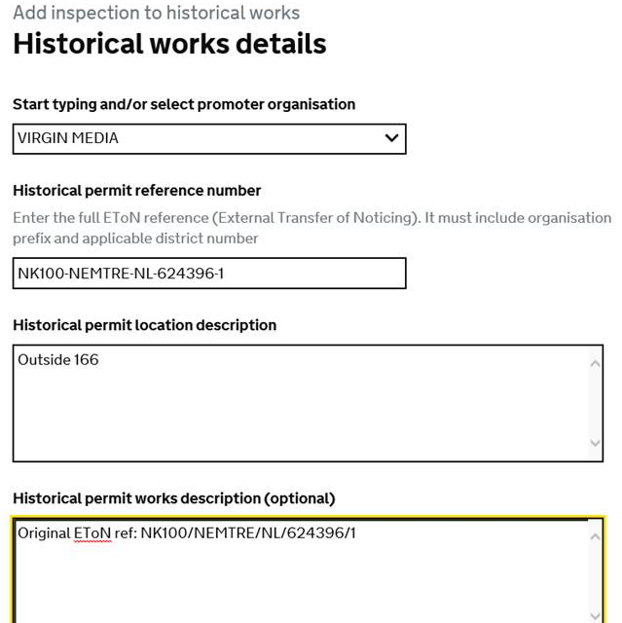

Work records/Permits
Did you know…?
By right clicking the ‘view on map’ button and selecting 'open in new tab', you can view the map and permit details side by side.
You can now upload more than one file at any one time, within a 10MB limit:
Uploading Multiple Files
Street Manager only supports the special characters hyphen and underscore. When creating a historic works for an EToN reference that contains special characters then replace the special characters with a hyphen or an underscore and ensure that the exact EToN reference is included in the historical permit works description field.

Slide 6







Section 81s
Did you know…?
There is a guide to the S81 journey as designed by the Street Manager project team:
S81 Journey
Pending enhancements to the S81 process, please follow the below tips:
Authority
1) To add a S81 type inspection, there is a link to add, or schedule, this type of inspection within the S81 works record page. This inspection type should only be used when carrying out an inspection on a S81 that has been previously reported.
2) Until such time that reassignment functionality is available, if a recorded S81 has been assigned to the incorrect promoter, the S81 record must be cancelled and a new one created to the correct promoter.
Promoter
To help the HA and SU identify a permit associated to a S81, when updating the S81 works record to ‘mark S81 as fixed’, the works record number (if applicable) of the works must be included in the additional details box.
Both
To make a comment related to a recorded S81, choose the topic type of general and insert the S81 works reference in the text box.

Slide 7
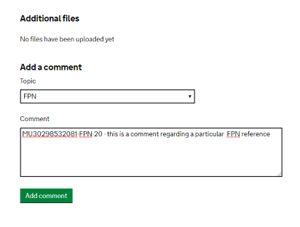
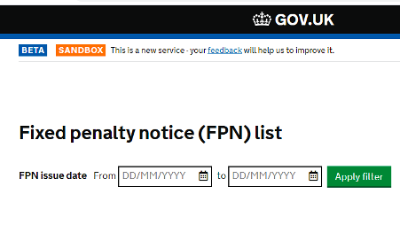
Fixed Penalty Notices
Interim solutions...
FPNs received
To check for Fixed Penalty Notices issued/received, click on the FPN tile which will display all FPN’s. Completing the date filter will limit the results. The export functionality is available on this tile for further analysis.
FPN Comments
When making a comment relating to a particular FPN, insert the FPN number into the comment box.

Slide 8

Section 58s
Did you know…?
Until such time as an exportable list view of activities becomes available in Street Manager, it is strongly recommended Highway Authorities send details of Section 58 restrictions to utility companies via email and are discussed at local coordination meetings.
Please note: Section 58 is currently available as an ‘activity type’ when raising a permit. It is highly recommended not to use the permit journey to raise Section 58s as this activity type will be removed from the list in the near future.
Interim solutions...
You can find the process in practice of adding an activity to record a S58 restriction:
Adding an activity to S58s

Slide 9
Comments
Interim solutions...
Pending functionality to withdraw a previously issued inspection, in instances where an inspection has been issued incorrectly or where a previous inspection outcome has been subsequently withdrawn an inspection type comment should be issued citing the inspection reference i.e. BR6101000208581-INSP-02 stating the reason for withdrawal.
A subsequent Routine inspection may be issued as a correction. It is highly recommended where a routine inspection is used as a correction, the initial inspection reference is cited in the additional comments section to be included within the inspection information.
Did you know…?
Pending enhancements to comment topic types, any comments on a works record should follow the below guide based on the subject of any comment:
Subject of comment | Topic type
All matters related to a Permit | General
Justification for extension after a duration challenge | General
Ongoing discussions re duration challenge | General
HA imposed changes discussion | General
All matters related to a S81/Unattributable | General
Subject of comment | Topic type
All matters related to an FPN | FPN
All matters related to an inspection | Inspection
Works/materials/plant/SLG present after end date | Overrun warning
All matters related to a Section 74 | Section 74

Slide 10


Unattributable works
Interim solutions...
Did you know…?
Pending functionality to support the issuing of unattributable works in Street Manager, a temporary solution is to utilise the Section 81 flow.
You can view how this works in principle, from creation to receiving & processing:
Unattributable works
Photos should be uploaded to the record to support the identification of unattributable works.

